Slide 1
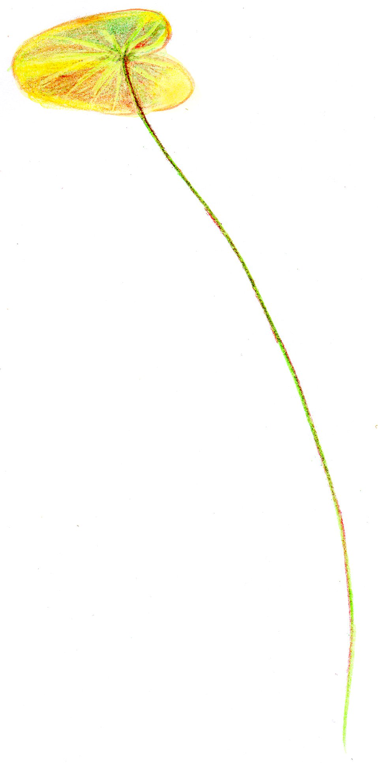
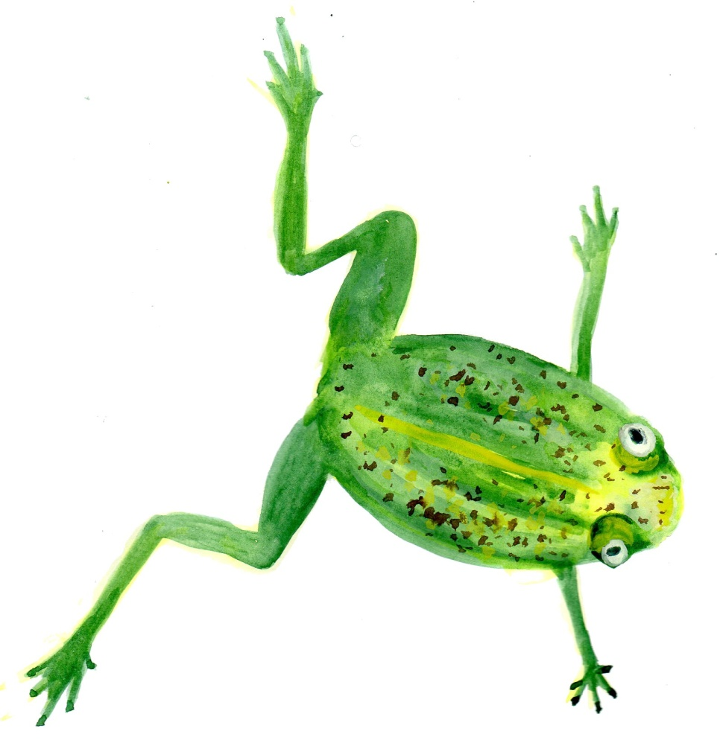
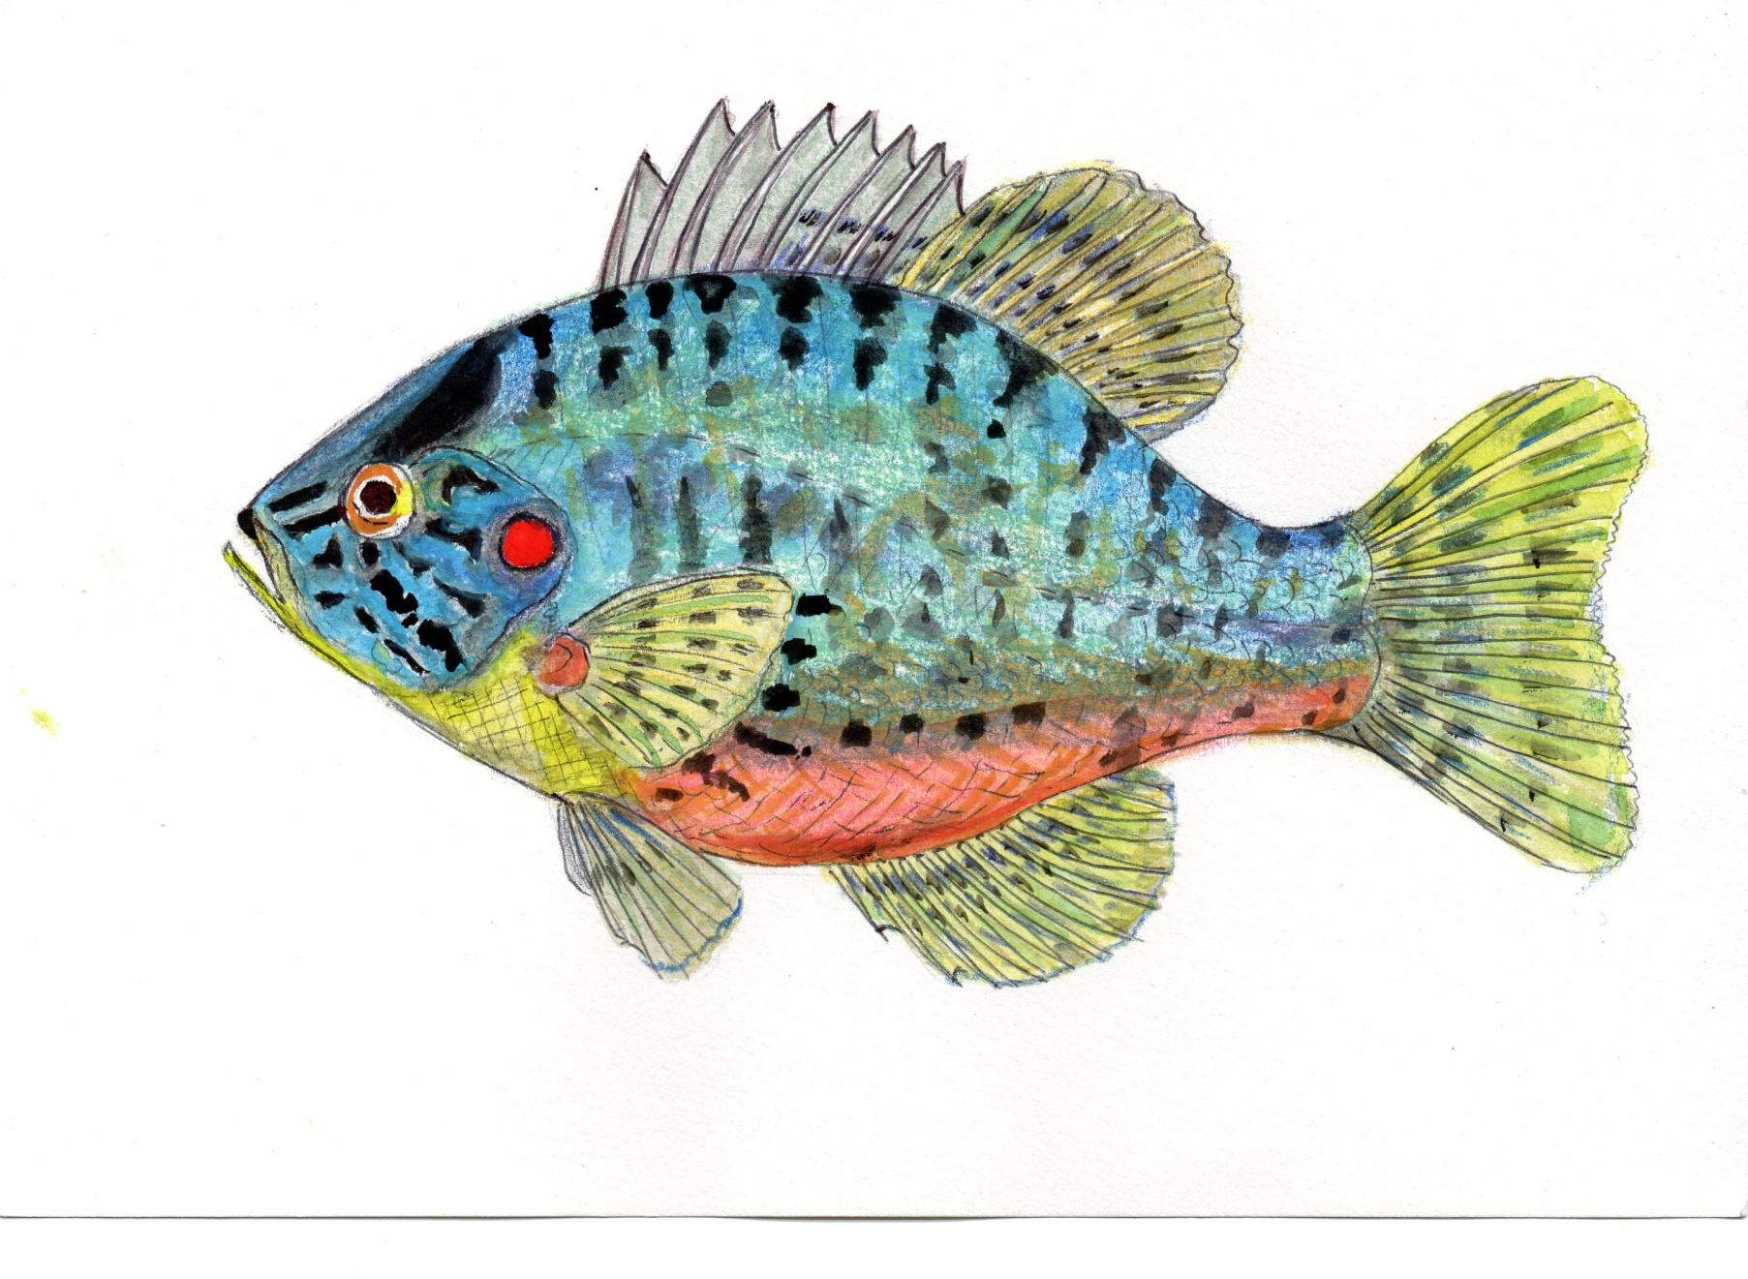
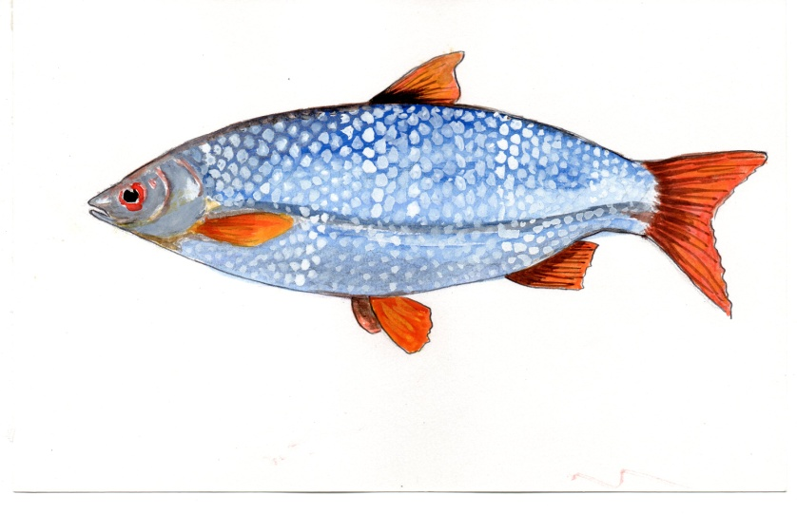
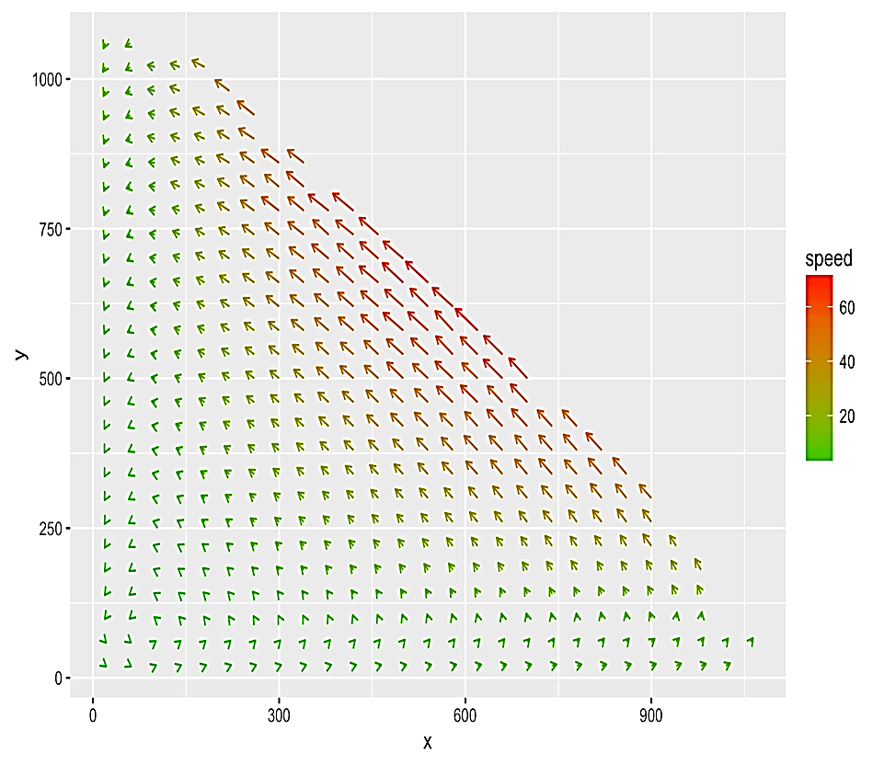
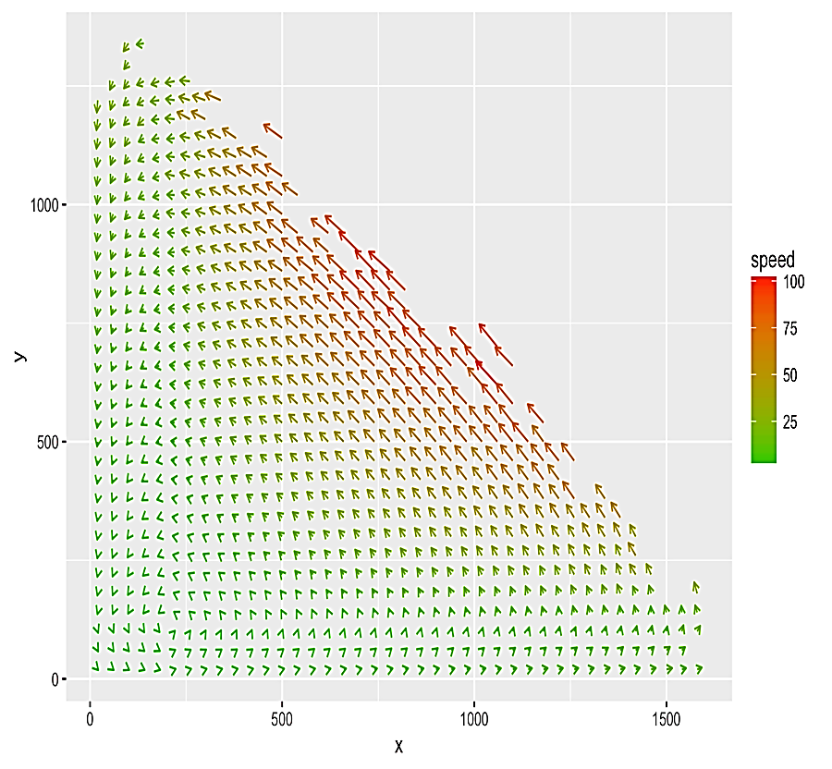
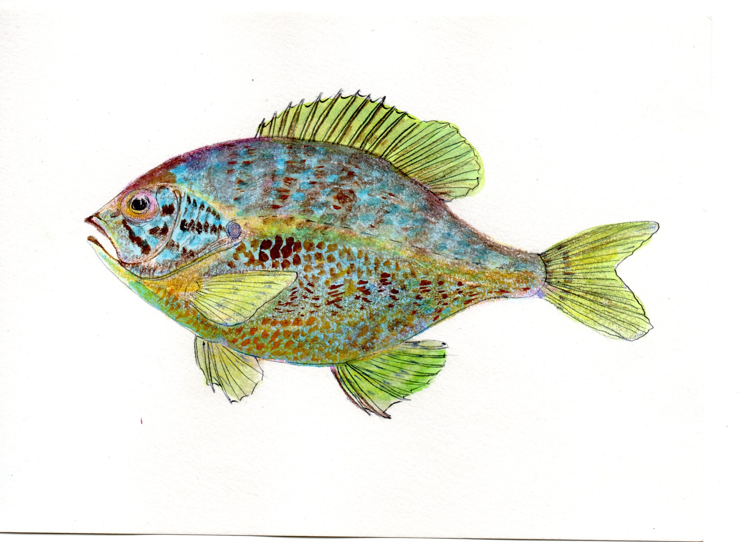
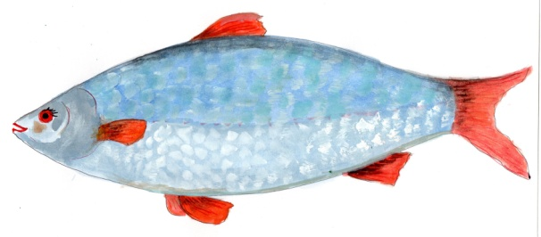
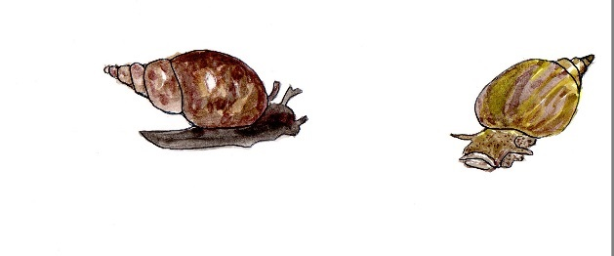

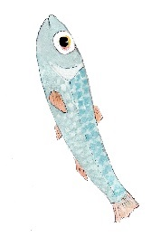
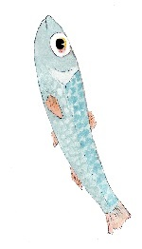
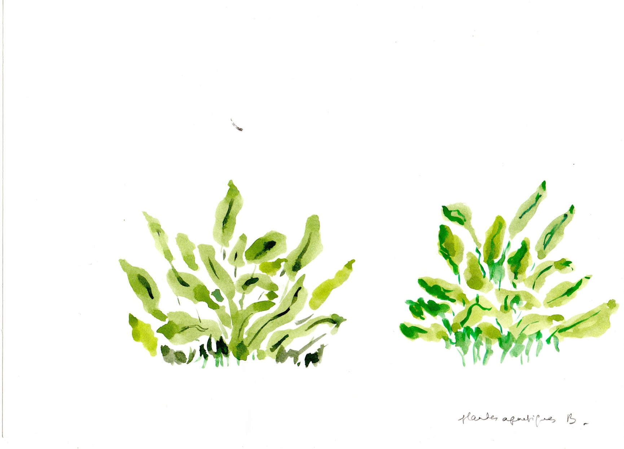
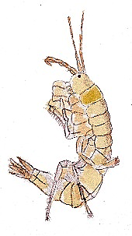
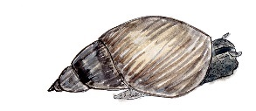
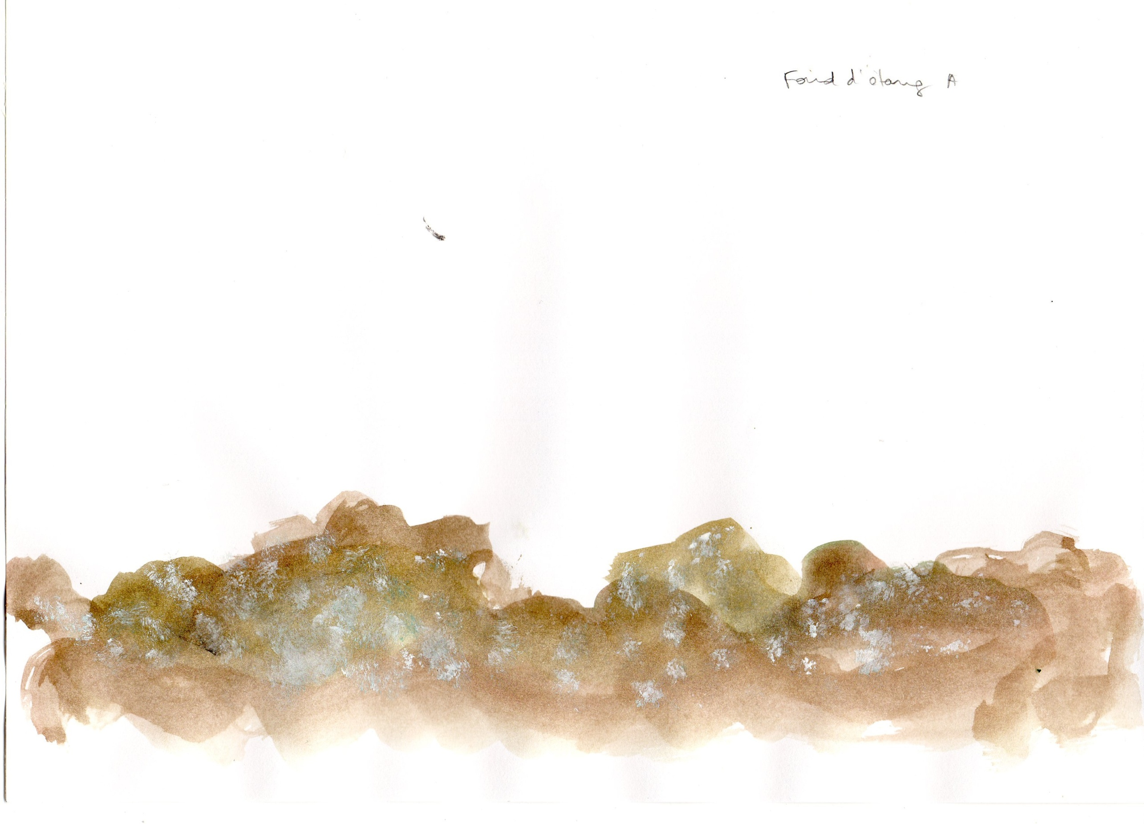
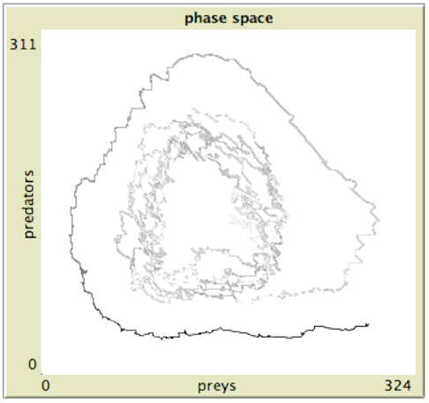
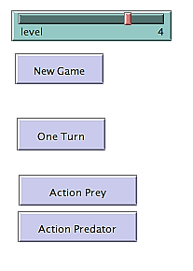
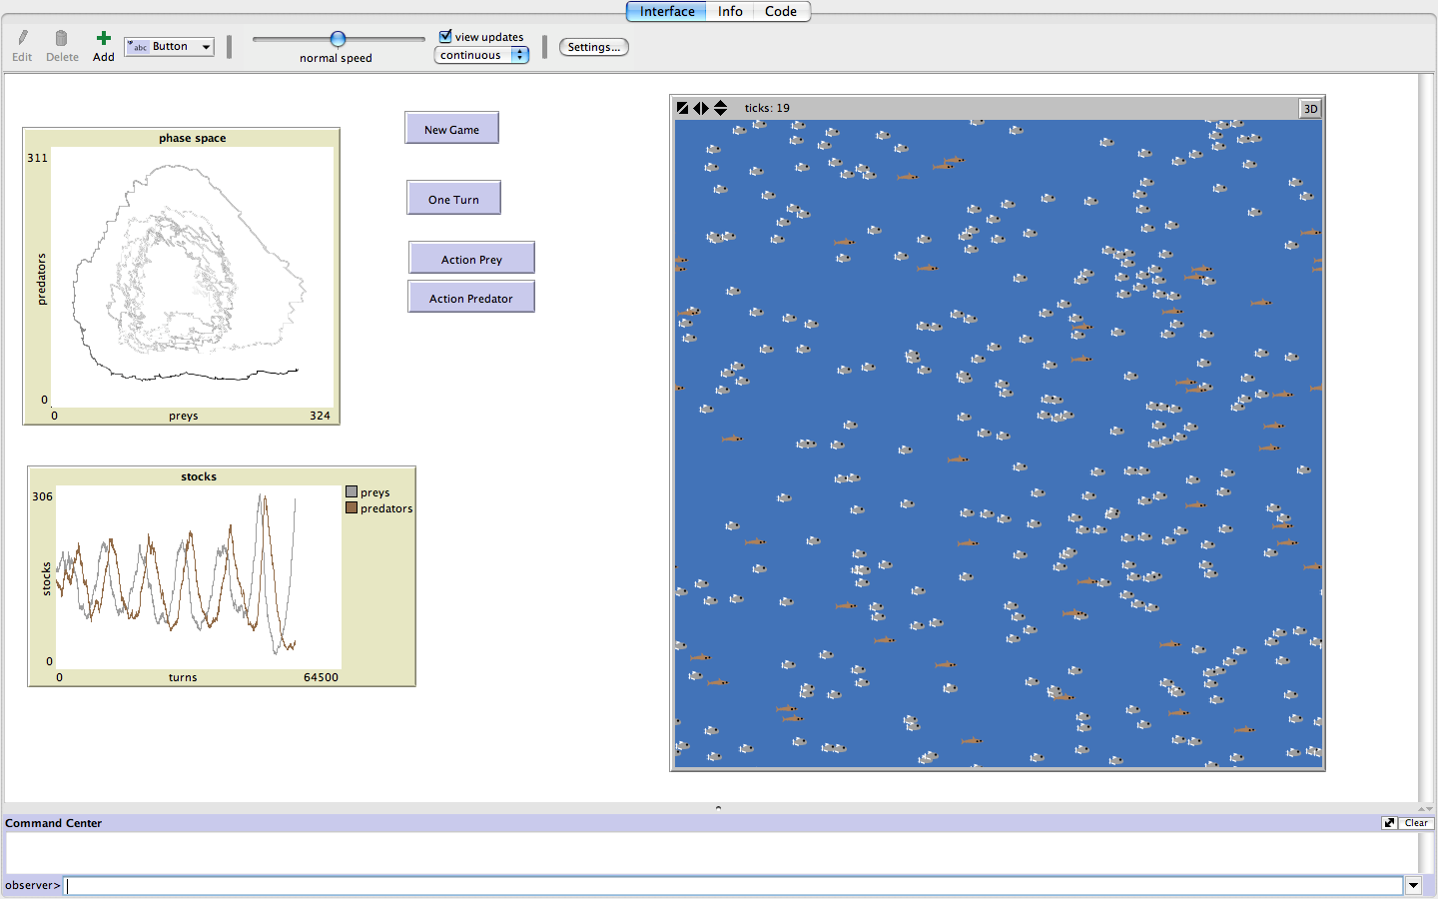

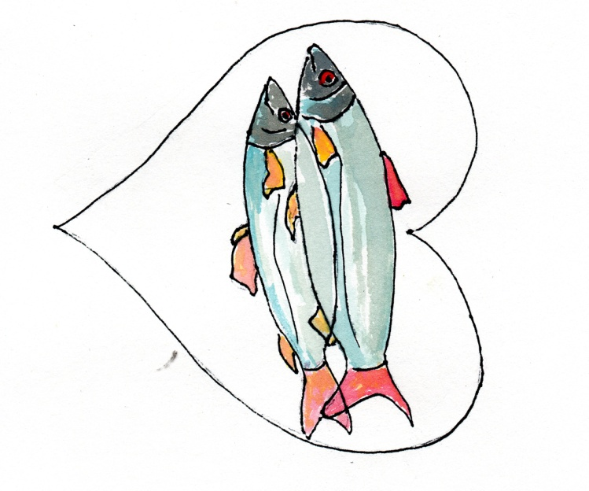
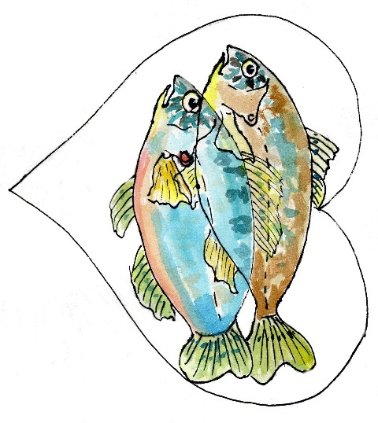
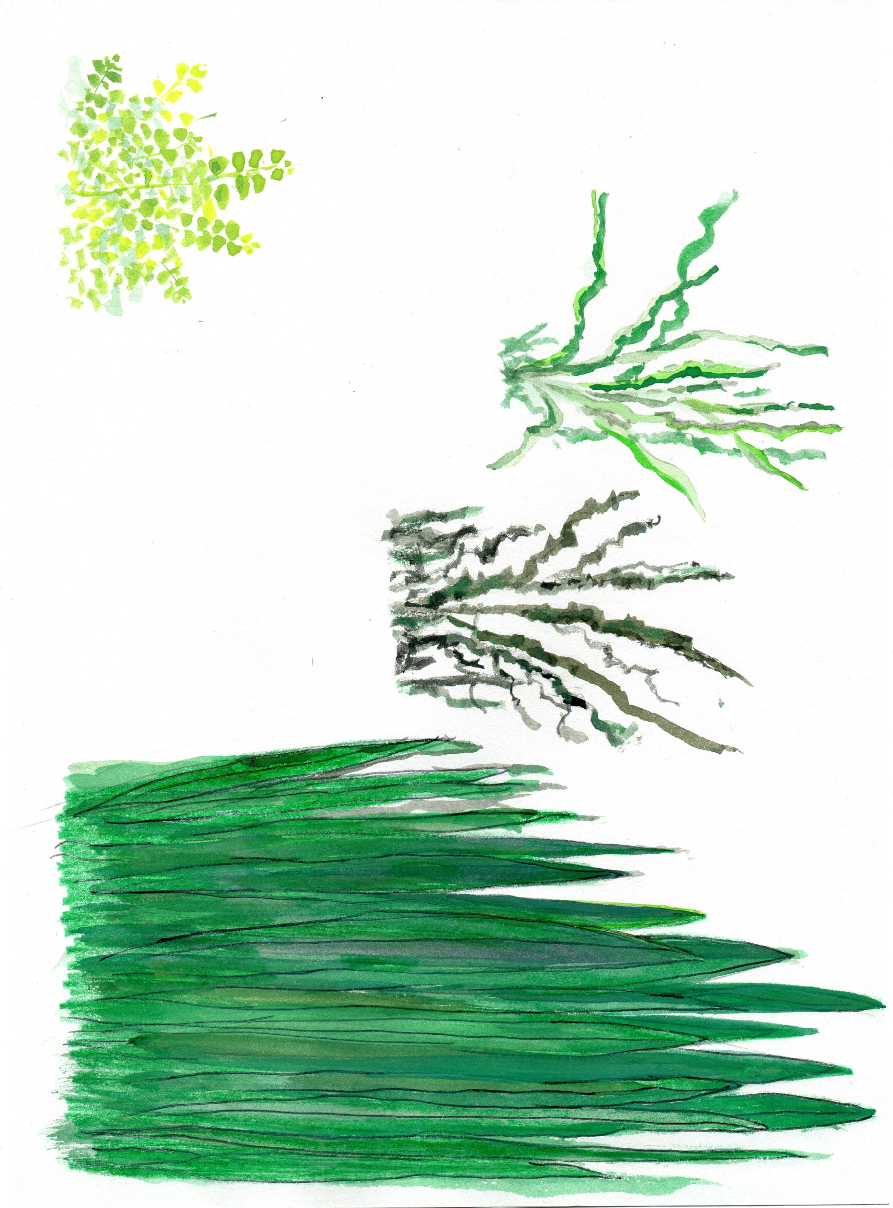
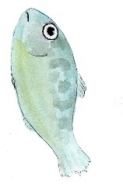

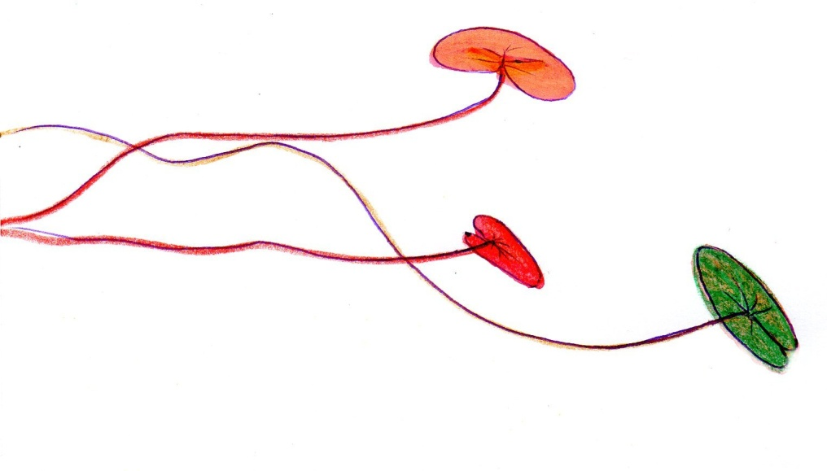
Game-based tools to transmit freshwater ecology concepts
SERRA, Hélène¹ , RAIMBAULT, Juste² *corresponding author: helene.serra@u-bordeaux.fr
¹ University of Bordeaux/UMR CNRS 5805 EPOC/LPTC, France
² University Paris 7, UMR CNRS 8504 Géographie-cités, France
INTRODUCTION
OBJECTIVE
METHODOLOGY
There is an increasing awarness of the public on environmental issues
Expert knowledge is often required to understand them
A need for simple and understandable tools to explain environmental issues
Games provide a virtual world with given boundaries (rules) that the player needs to understand and to follow to win
Furthermore, games are dynamic and interactive: the player engagement and its knowledge retention increase
→ Games display interesting features to spread scientific thinking¹
TO DEVELOP A BOARD GAME AND A COMPUTER-BASED GAME TO EXPLAIN THE BASIC CONCEPTS OF AQUATIC ECOLOGY
STEP 1
CONTEXT
Aim of the game
Aquatic species and ecological concepts
Inclusion of time and chance
STEP 2
PROTOTYPES
Design of the games (players , token, board)
Size and layout of the board
Coding and calibration of the model
The games aim to be complementary:
in term of player interactions and system dynamics
→ in the targeted players (groups vs isolated gamers)
STEP 3
TEST AND
EVALUATION
Gather player feedbacks
Refining and adapting the games
STEP 4
DIFFUSION
Identification of funding opportunities
Construction of a diffusion network
BOARD GAME
COMPUTER BASED GAME
DEVELOPMENT OF THE PROTOTYPE
DEVELOPMENT OF THE PROTOTYPE
Context
The player is a fish, either a predator or a prey
The objective of the game is to reach a stable population of fish
Concepts illustrated: feeding strategy, reproduction, predation and competition
Basis of the board game
Species: the roach (Rutilus rutilus) as a prey and the pumpkinseed (Lepomis gibbosus) as a predato, two common european small fish
Illustration of a native european shoal fish (the roach) and of an invasive species (the pumpkinseed) with specific life history characteristics
The board represents the edge of a lake with plants, crustaceans, and mollusks
The player choses a fish species and starts the game with 2 token (male +female)
The players use dices to move the tokens on the board and to find ressources
Each ressource provides the fish with a given amount of energy that he accumulates
This energy can further be used to reproduce (adult fish), to grow (juvenile) or to attack a prey (predator)
Each turn, the player takes a card « chance » representing the events impacting the lake
Ecological characteristics of each player:
STEP 1
Context
The player controls an ecosytem with preys (the roach) and predators (the pumpkinseed)
The objective of the game is to maintain the stability of the ecosystem
Concepts illustrated: population dynamic and ecosystem resilience
Basis of the computer-based game:
An agent-based model² for a simple prey-predator system is proposed as a basis of the computer game (Netlogo software)
ABM simulate the behavior and interactions between agents (fish) to reconstruct the population dynamic (bottom-up approach)
Stochasticity is included with spatialized interactions (smoothed brownian motions), illustrating the randomisation of prey-predator interactions
Parameter: survival rate
Parameter: predator hunting rate
PREDATION
HOW TO PLAY THE GAME
Parameter: reproduction rate
STEP 2
Model calibration:
Systematic exploration of parameter space using OpenMole software³, to verify theoretical average trajectories in phase space, which allows analytical and numerical determination of initial position (attractor) and justify the use of this system for the game. The figures show estimated average trajectories for two points in parameter space.
EXAMPLE OF « CHANCE » CARD
HOW TO PLAY THE GAME
PLAYER 1: PREY
PLAYER 2: PREDATOR
A solitary pike is swimmig around… Watch out! You just lost one fish
Tonight is full moon. You see as well as in day light: play again
The player starts the game with a stable ecosystem: the initial position is the attractor
The button « one turn » makes the ecosystem evolve during 50 time steps
The player sees the changes in the fish populations simustaneoulsy on the screen
The trajectory can be corrected towards the attractor in the phase space by changing the parameters of the model (predator survival, prey reproduction and hunting behavior)
External events randomly perturbate the ecosystem
The game includes 5 levels of difficulty based on event strength
The roach
RESSOURCES
The pumpkinseed
The forestry guards cut threes near the lake: plants become much more light! Snails eat much more, they bring twice more energy for 2 turns
A fisherman put his boat onto the water. He repainted it with antifouling: no mollusk for 2 turns
Crustaceans and mollusks
Roach juveniles and crustaceans
REPRODUCTION
PREDATION
COMPETITION
+
Opening of a fishing contest. The introduced fish destroyed the whole bottom of the lake: no more ressources in the area for 2 turns.
Phase space figuring in Y axis the predators and in X xis the preys
(Netlogo interface)
attractor
The stock: representation of the oscillations in fish populations (Netlogo interface)
The ecosystem: representation of the fish populations
(Netlogo interface)
The eggs stick to the plants
The eggs are layed in a nest done by the male
Open source: code available at https://github.com/JusteRaimbault/MediationEcotox
DISCUSSION
PERSPECTIVES
Demonstration of the proof-of-concept: the prototypes are available for testing
Both game are complementary as they integrate different time scales and illustrate diverse basic concepts of aquatic ecology
No knowledge in aquatic ecology is needed to play both games: wide possibilities in targeted audiences
The methodology is flexible and adaptable:
On-going development of the games
Refinements and changes are easy to integrate in new versions of the games
Short term perspectives:
Next step of the project: test the games and gather player feedbacks → do players like the games?
Identification of potential players (children, school/university, family, adults…) and adaptation of the games accordingly (simplication/complexification)
Long term perspectives:
Potential uses of the games as educational tools (with educative support) or sensibilisation tools (e.g. adapting the species and perturbations)
Funding and diffusion of the board game through crowdfunding plateforms and game festivals
Diffusion of the computer-based game: open online access through Netlogoweb and development of mobile applications
References: ¹Morris, B. J. et al. (2013). Gaming science: the “Gamification” of scientific thinking. Frontiers in psychology, 4. - ²Grimm, V., et al. (2005). Pattern-oriented modeling of agent-based complex systems: lessons from ecology. Science, 310(5750), 987-991. - ³Reuillon, R., et al. (2013). OpenMOLE, a workflow engine specifically tailored for the distributed exploration of simulation models. Future Generation Computer Systems, 29(8), 1981-1990.

